Slide 1


Exploratory Data Analysis of weather
Submitted by:- sahil

Slide 2

Introduction
"In this EDA presentation, we explore historical weather data to uncover trends and patterns. Analyzing temperature, precipitation, and other variables, we aim to understand weather dynamics and their impact. Through visualizations and analysis, we provide insights into weather history, informing decision-making and understanding climate trends."

Slide 3

Objective of our project
EDA
Cleaning the data.
Identifying Trends and Patterns
Turn this raw data into a information.
Visualizing the patterns
Understanding Weather Patterns

Slide 4
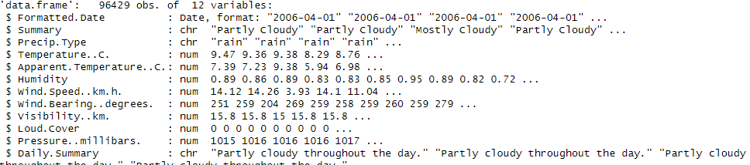
All information of our dataset

Slide 5
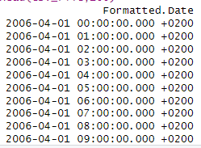
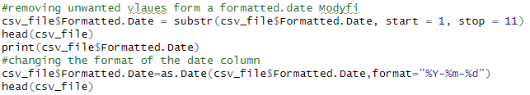
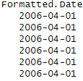
Previously we are having this kind of date format so we change the format using above query we fix the date format.

Slide 6

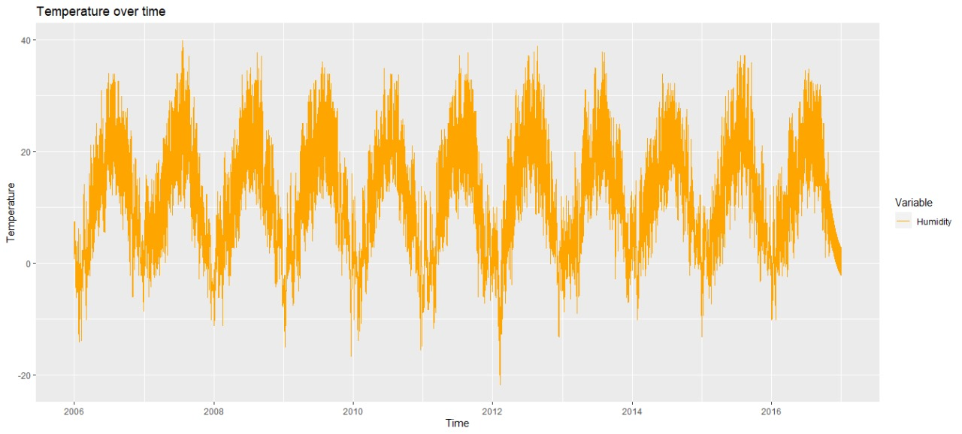
How does temperature vary over time?

Slide 7
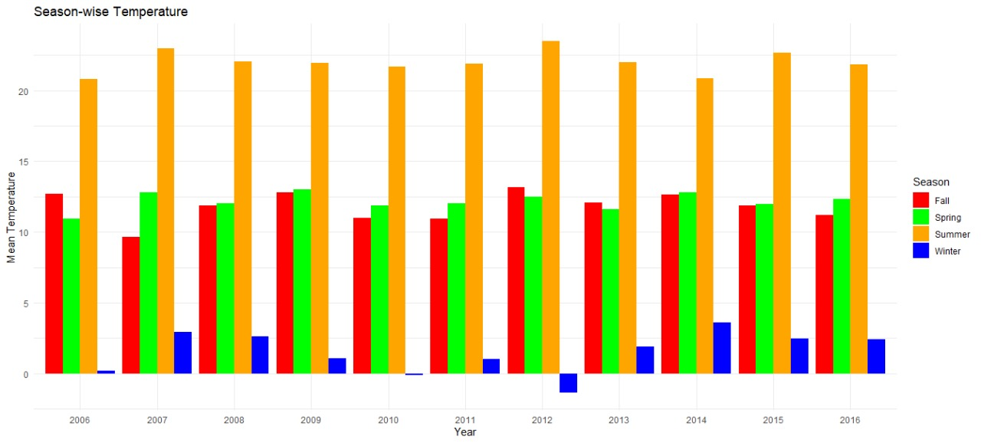
Are there any seasonal trends in temperature?

Slide 8

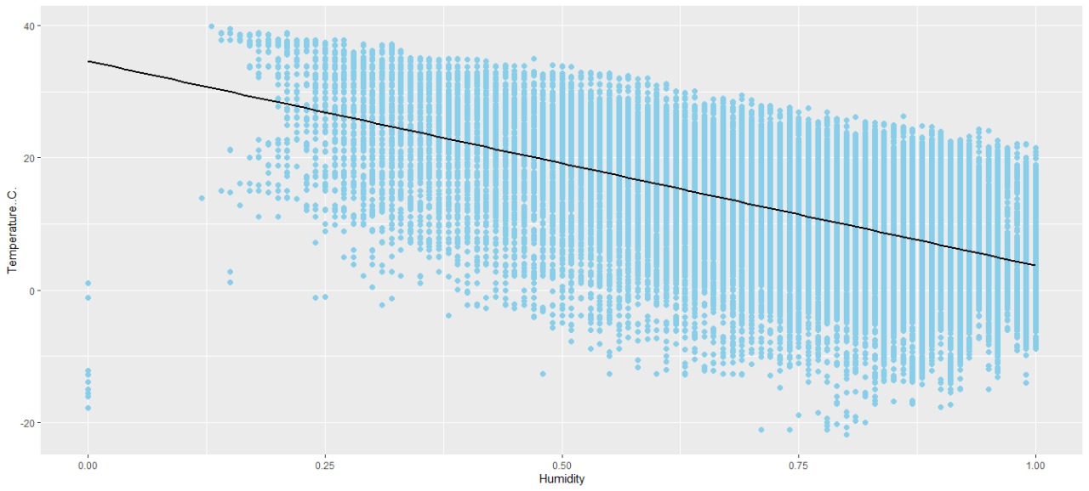
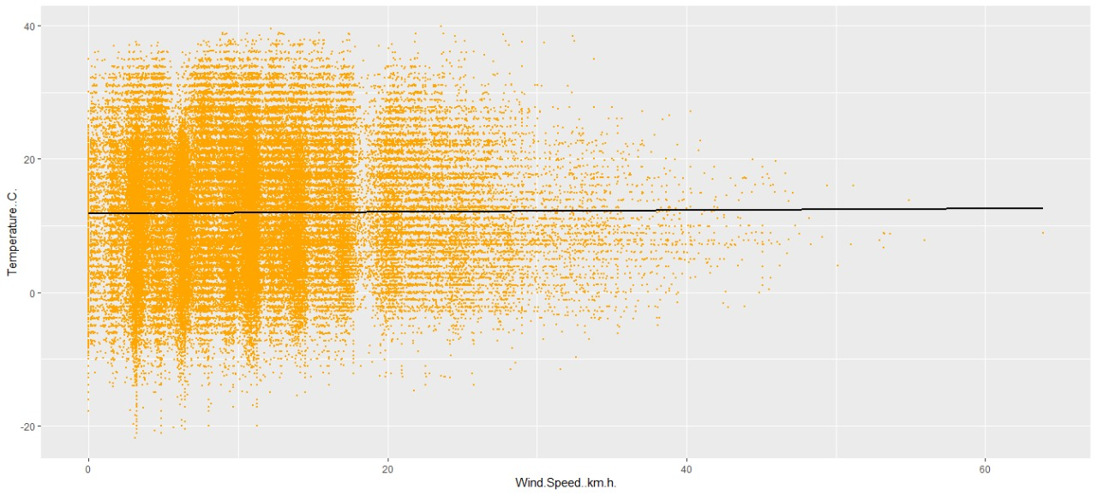
How do temperature and apparent temperature vary with other variables like humidity or wind speed?

Slide 9

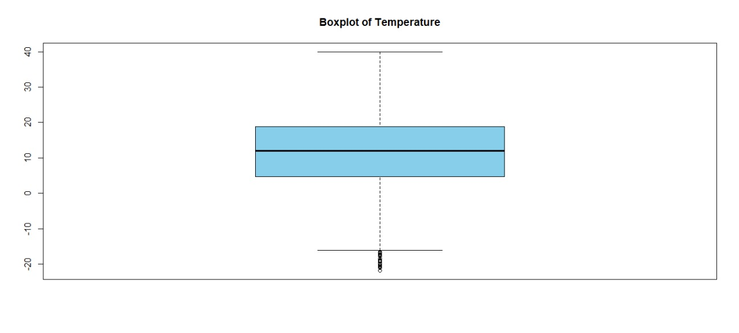
Are there any outliers in temperature?

Slide 10

Are there any outliers in temperature?
Using this query we found out some outliers

Slide 11
Thank you

